Slide 1
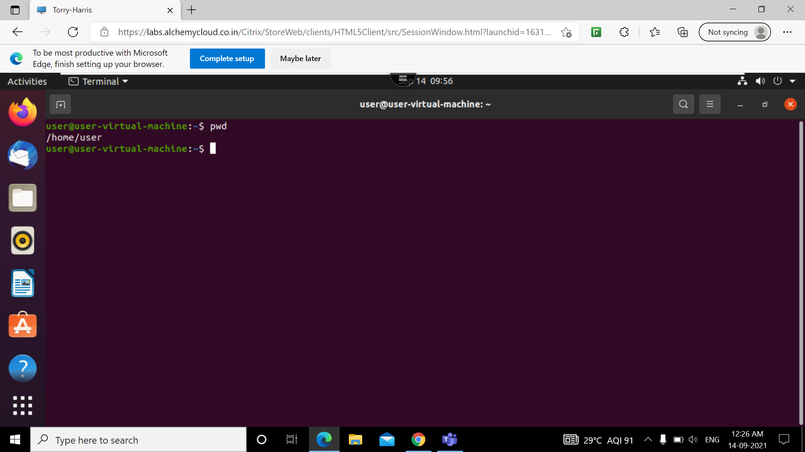
PWD: PRESENT WORKING DIRECTORY
writes the full path name of the current working directory to the standard output.

Slide 2
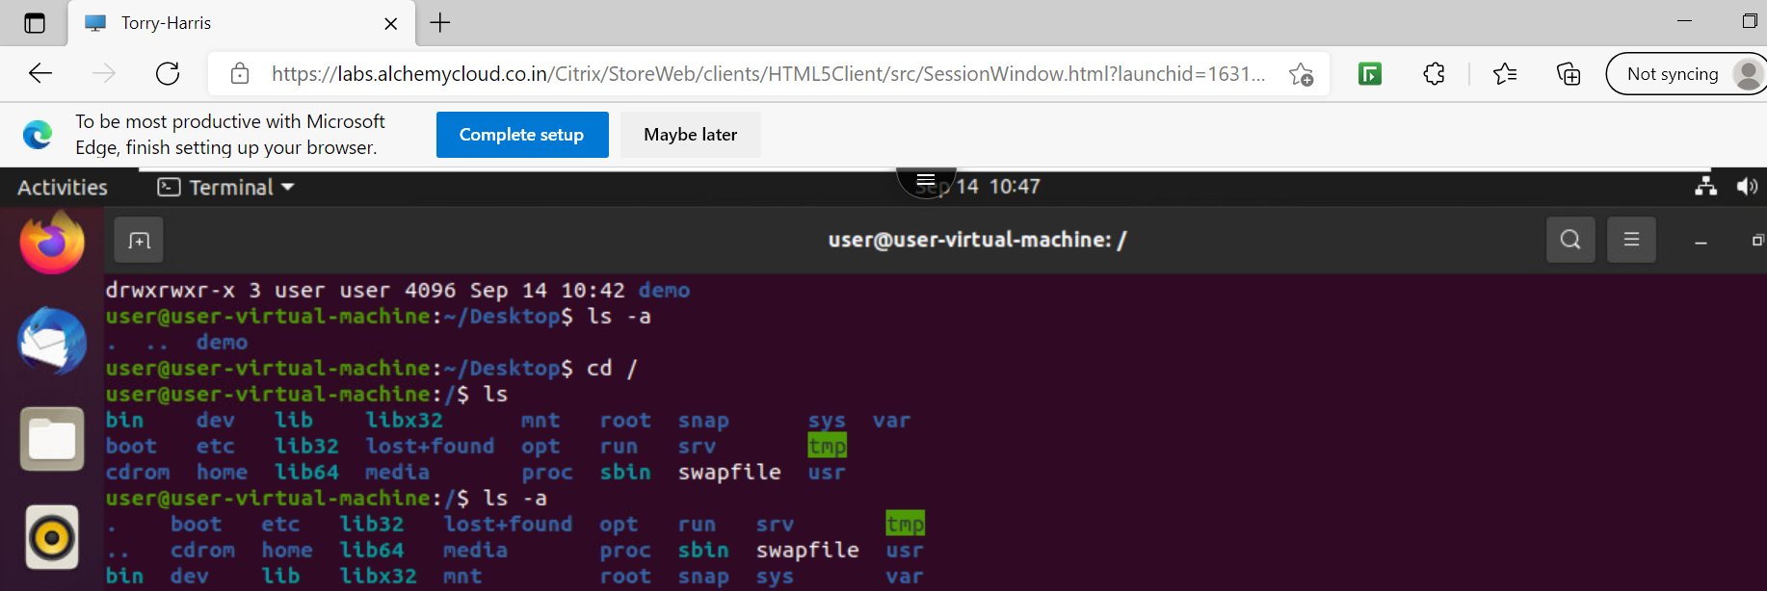
Ls
Lists the names of files in a particular Unix directory

Slide 3
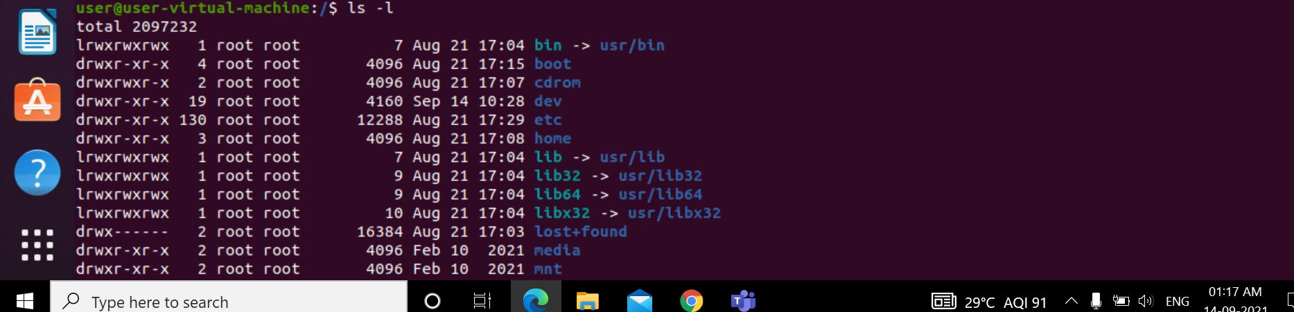
Ls -l
ls -l. The -l option signifies the long list format. This shows a lot more information presented to the user than the standard command.

Slide 4
Ls -a
The (ls -a) command will enlist the whole list of the current directory including the hidden files.

Slide 5
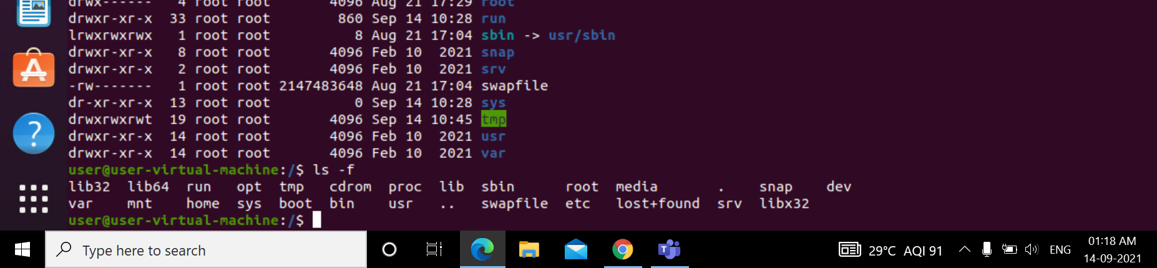
Ls -f
ls -f will display all the files, but without a sorted order

Slide 6
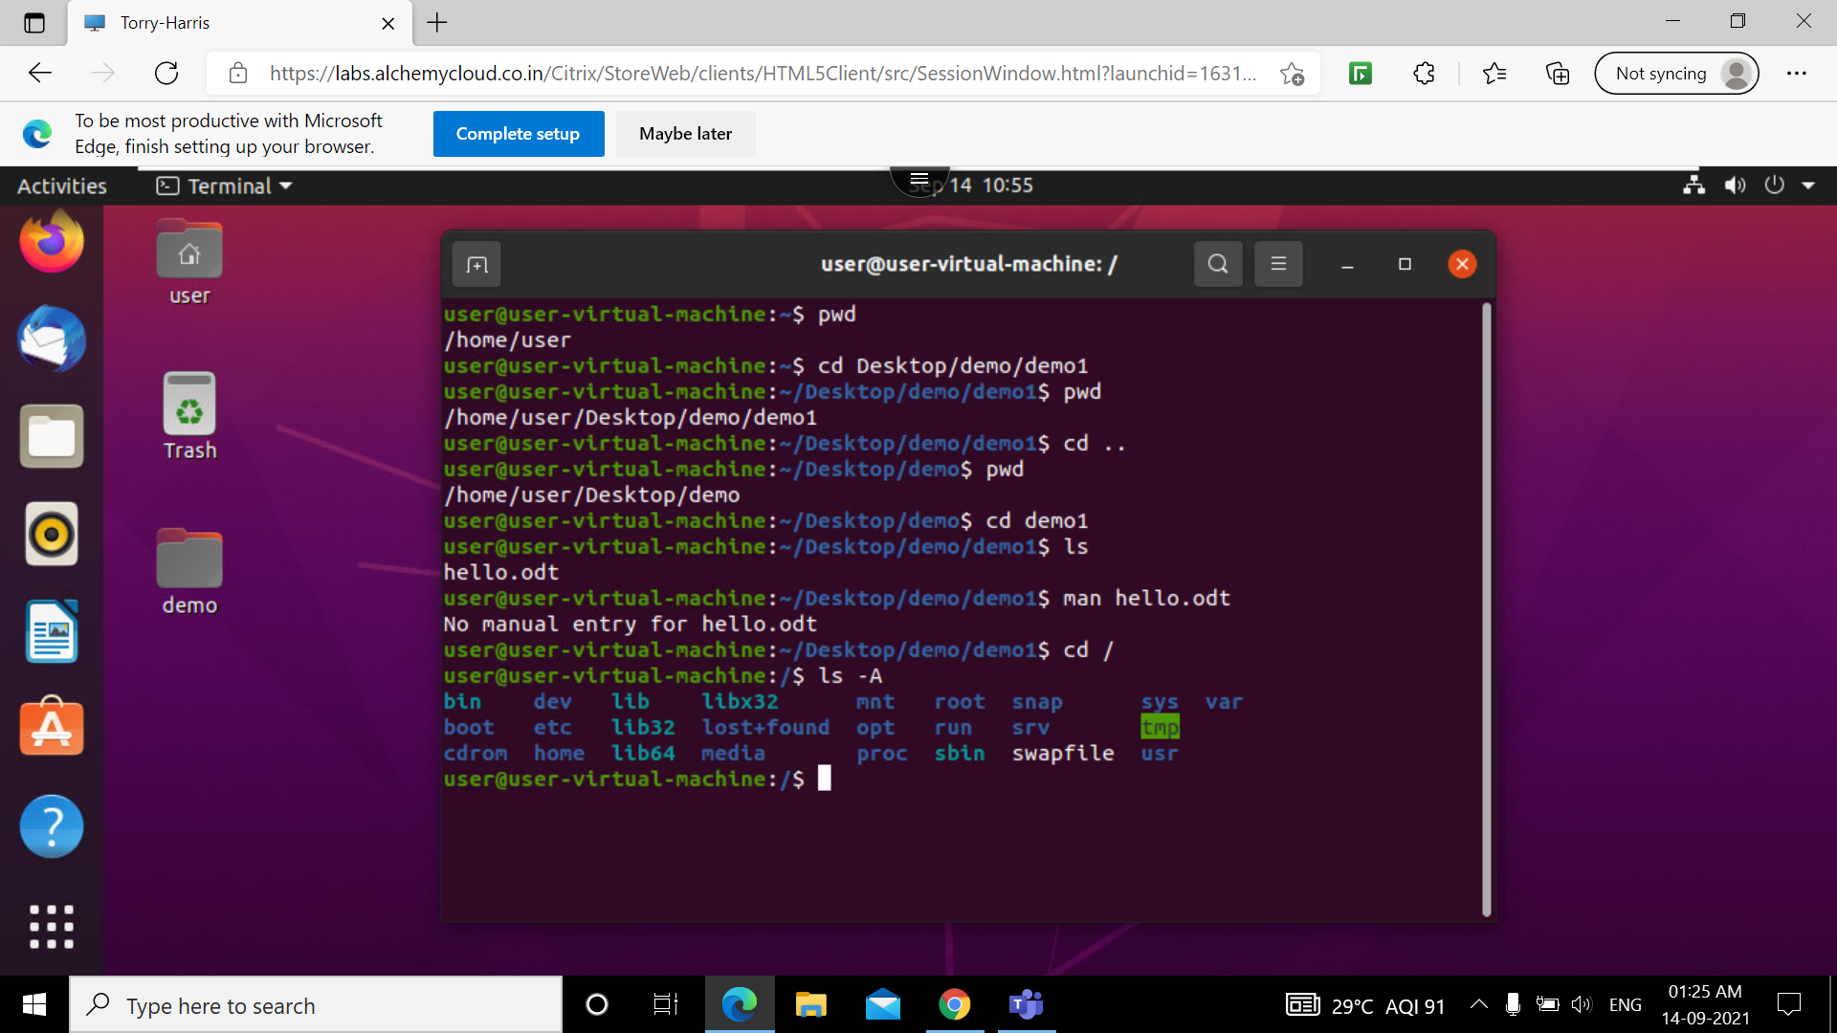
Ls -A
The (ls -a) command will enlist the whole list of the current directory excluding the hidden files.

Slide 7
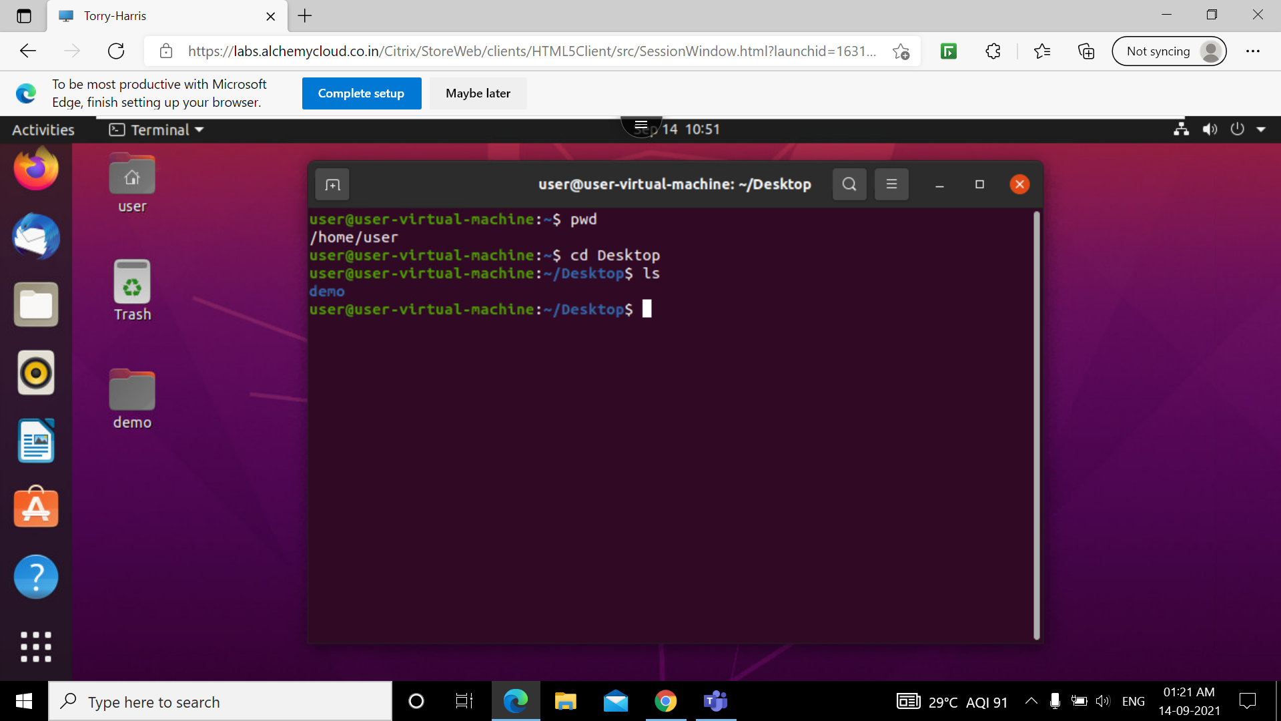
Cd Desktop
cd command in linux known as change directory command. It is used to change current working directory

Slide 8

Cd ..
command used to change from current working directory to its parent directory

Slide 9
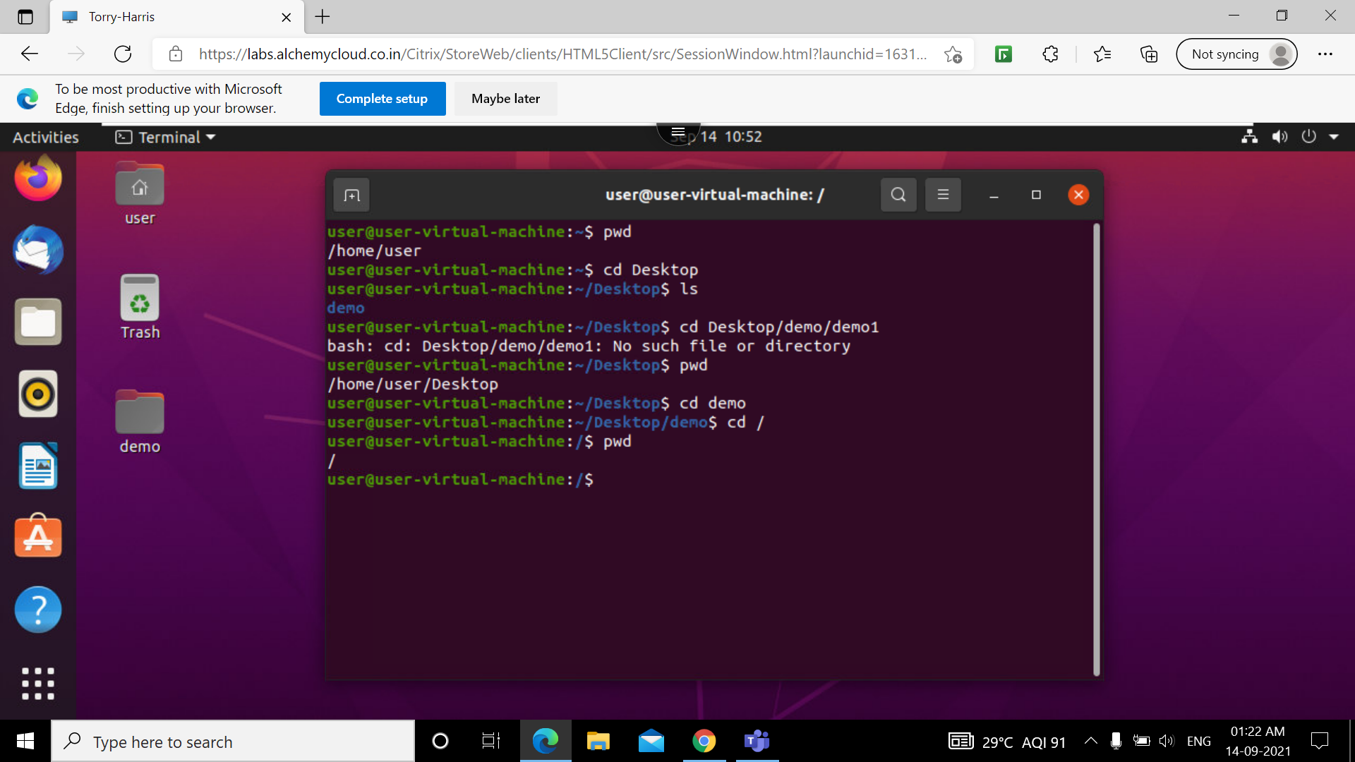
Cd /
This command cd / changes current working directory to the root directory. typing cd / will bring the user to the root.

Slide 10
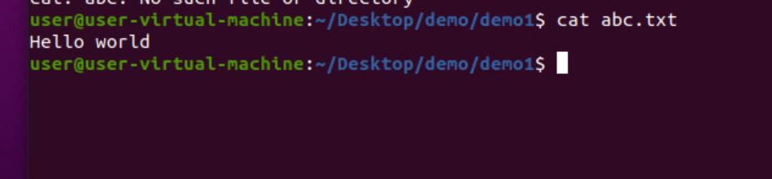
cat
It reads data from the file and gives their content as output. It helps us to create, view, concatenate files.

Slide 11
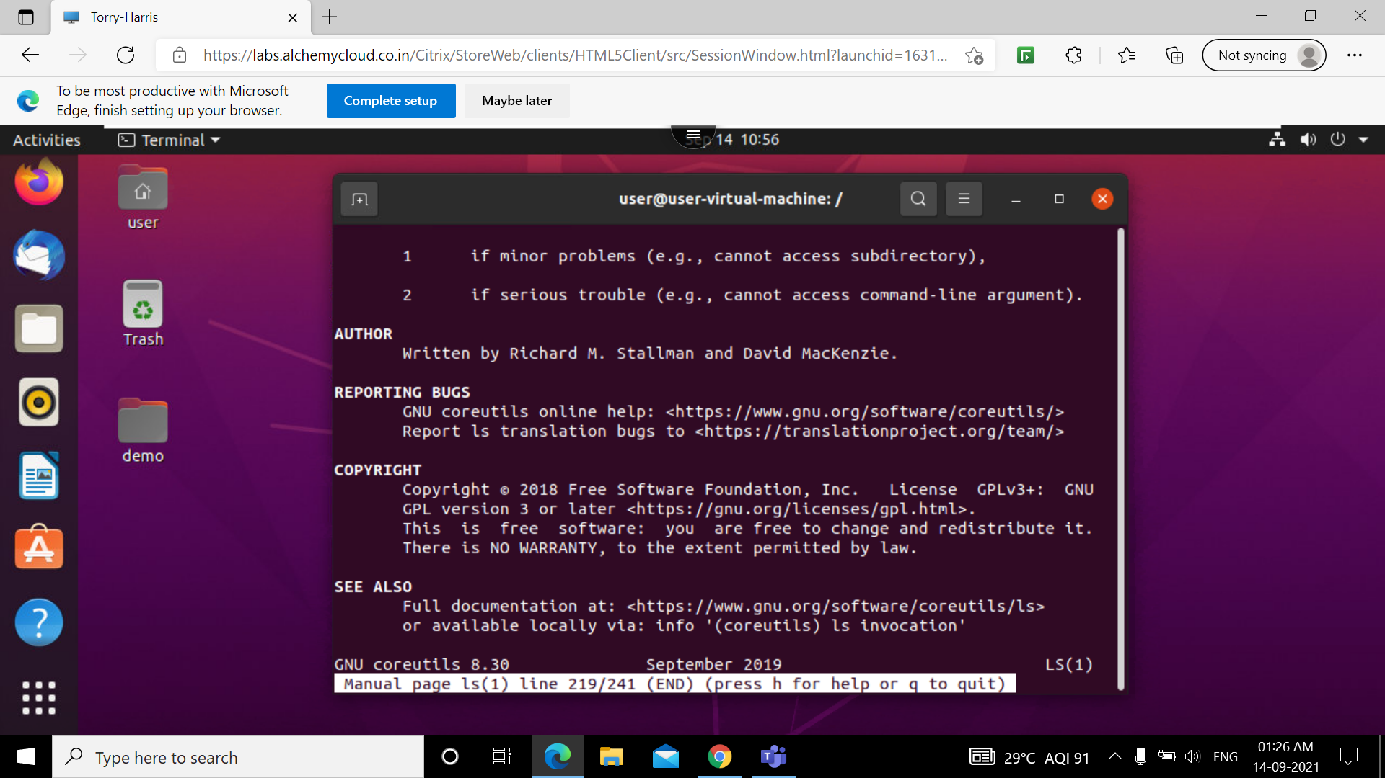
Man
man command in Linux is used to display the user manual of any command that we can run on the terminal. It provides a detailed view of the command which includes NAME, SYNOPSIS, DESCRIPTION, OPTIONS, EXIT STATUS, RETURN VALUES, ERRORS, FILES, VERSIONS, EXAMPLES, AUTHORS .

Slide 12
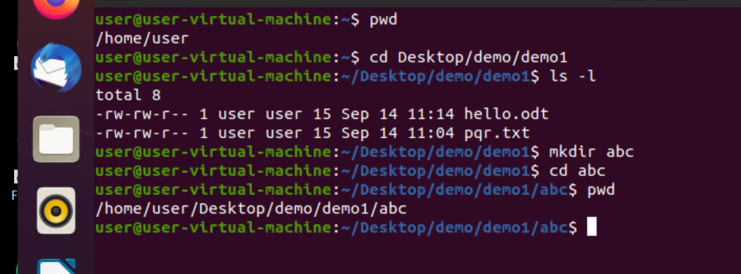
mkdir
This command is used to create new directory from present working directory

Slide 13
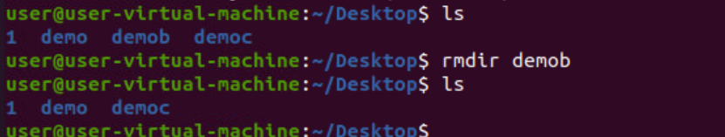
rmdir
The rmdir command removes the directory, specified by the Directory parameter, from the system. The directory must be empty before you can remove it, and you must have write permission in its parent directory.

Slide 14
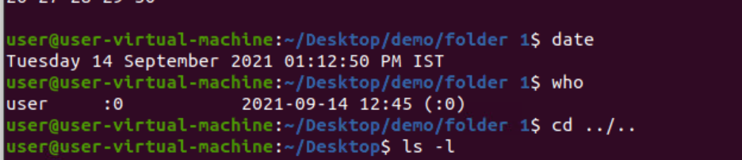
who
The standard Unix command who displays a list of users who are currently logged into the computer.

Slide 15
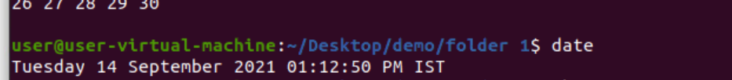
date
date command is used to display the system date and time. date command is also used to set date and time of the system. By default the date command displays the date in the time zone on which unix/linux operating system is configured.

Slide 16
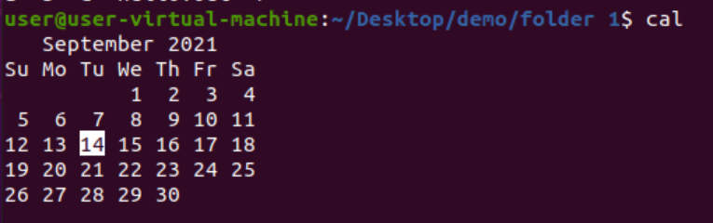
cal
The cal command displays a calendar of the specified year or month. The Year parameter names the year for which you want a calendar

Slide 17
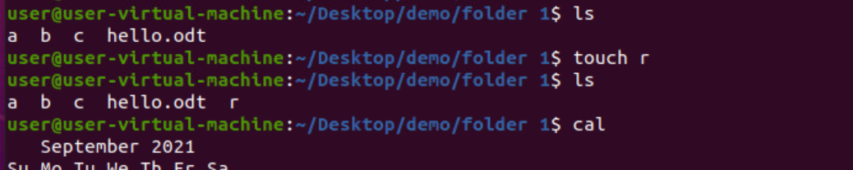
touch
The touch command is a standard command used in UNIX/Linux operating system which is used to create a file

Slide 18
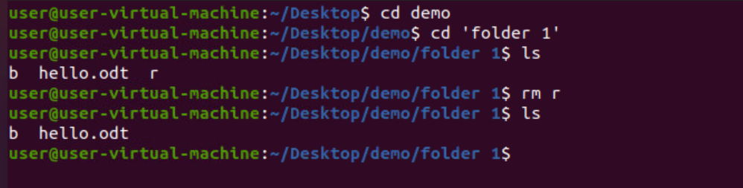
rm
rm command is used to remove objects such as files, directories, symbolic links and so on from the file system like UNIX.

Slide 19
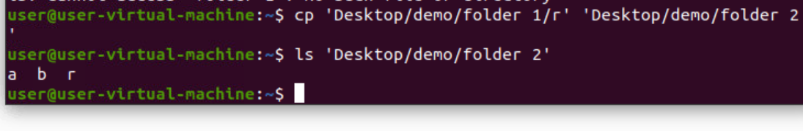
cp
The Linux cp command is used for copying files and directories to another location

Slide 20
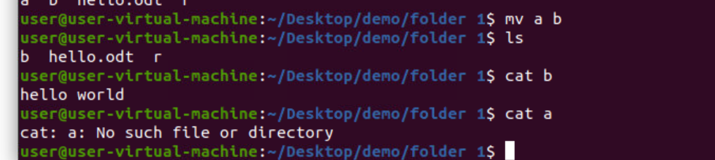
mv
Linux mv command is used to move existing file or directory from one location to another. It is also used to rename a file or directory.

Slide 21
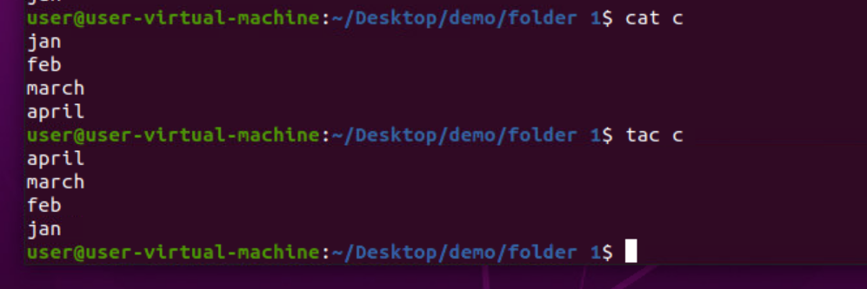
tac
tac command in Linux is used to concatenate and print files in reverse. This command will write each FILE to standard output, the last line first. When no file is specified then this command will read the standard input.

Slide 22
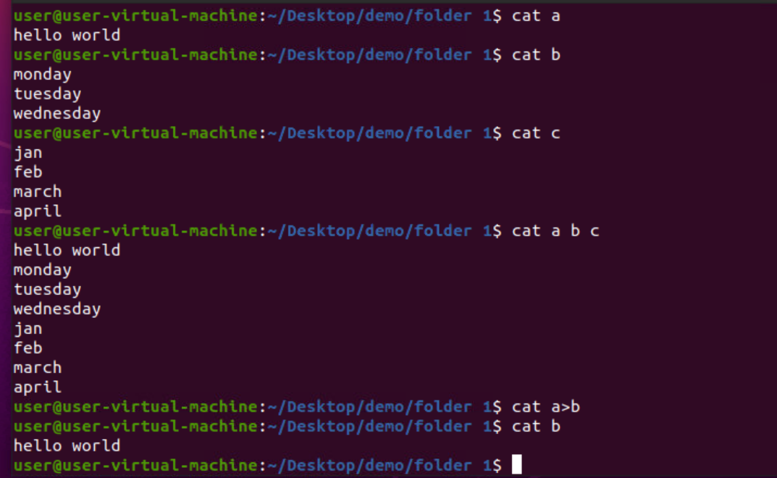
Cat a b c
Used to display data of all file at the same time.

Slide 23
Cat a>b
This command copies the file 'a' content to file 'b'

Slide 24
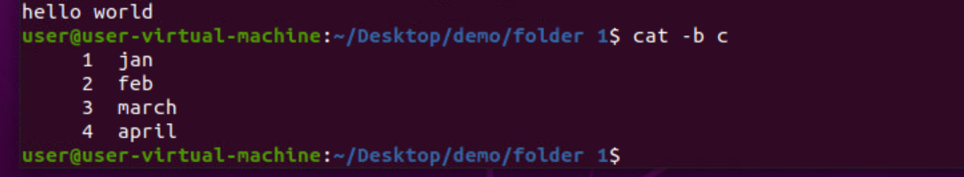
Cat –b
This command is used to display the contents of the file along with line number

Slide 25
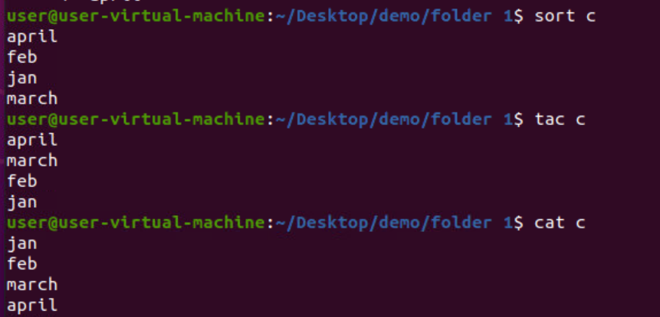
sort
SORT command is used to sort a file, arranging the records in a particular order. By default, the sort command sorts file assuming the contents are ASCII.

Slide 26
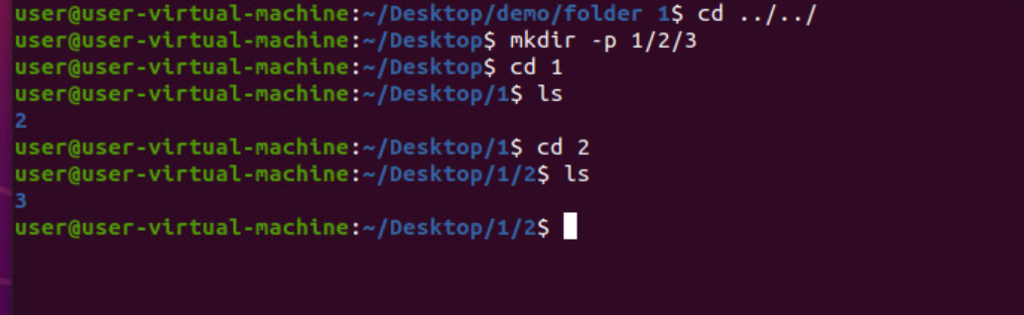
Mkdir -p
With the help of mkdir -p command you can create sub-directories of a directory. It will create parent directory first, if it doesn't exist. But if it already exists, then it will not print an error message and will move further to create sub-directories.

Slide 27
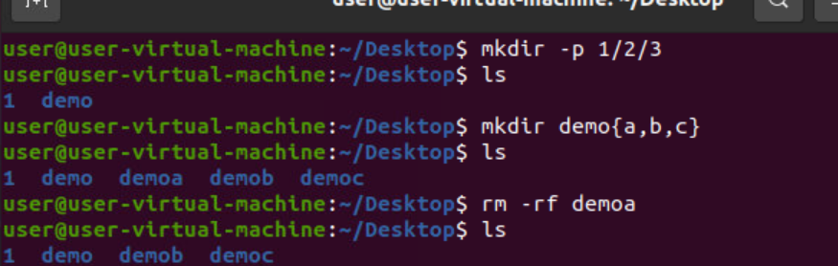
Mkdir demo{a,b,c}
Creates multiple directories in current working directory

Slide 28
Rm -rf
The rm -rf command is one of the fastest way to delete a folder and its contents. Linux rm -rf command deletes directory forcefully. It means a file or directory will be deleted anyhow even if it has read-only permission.

Slide 29
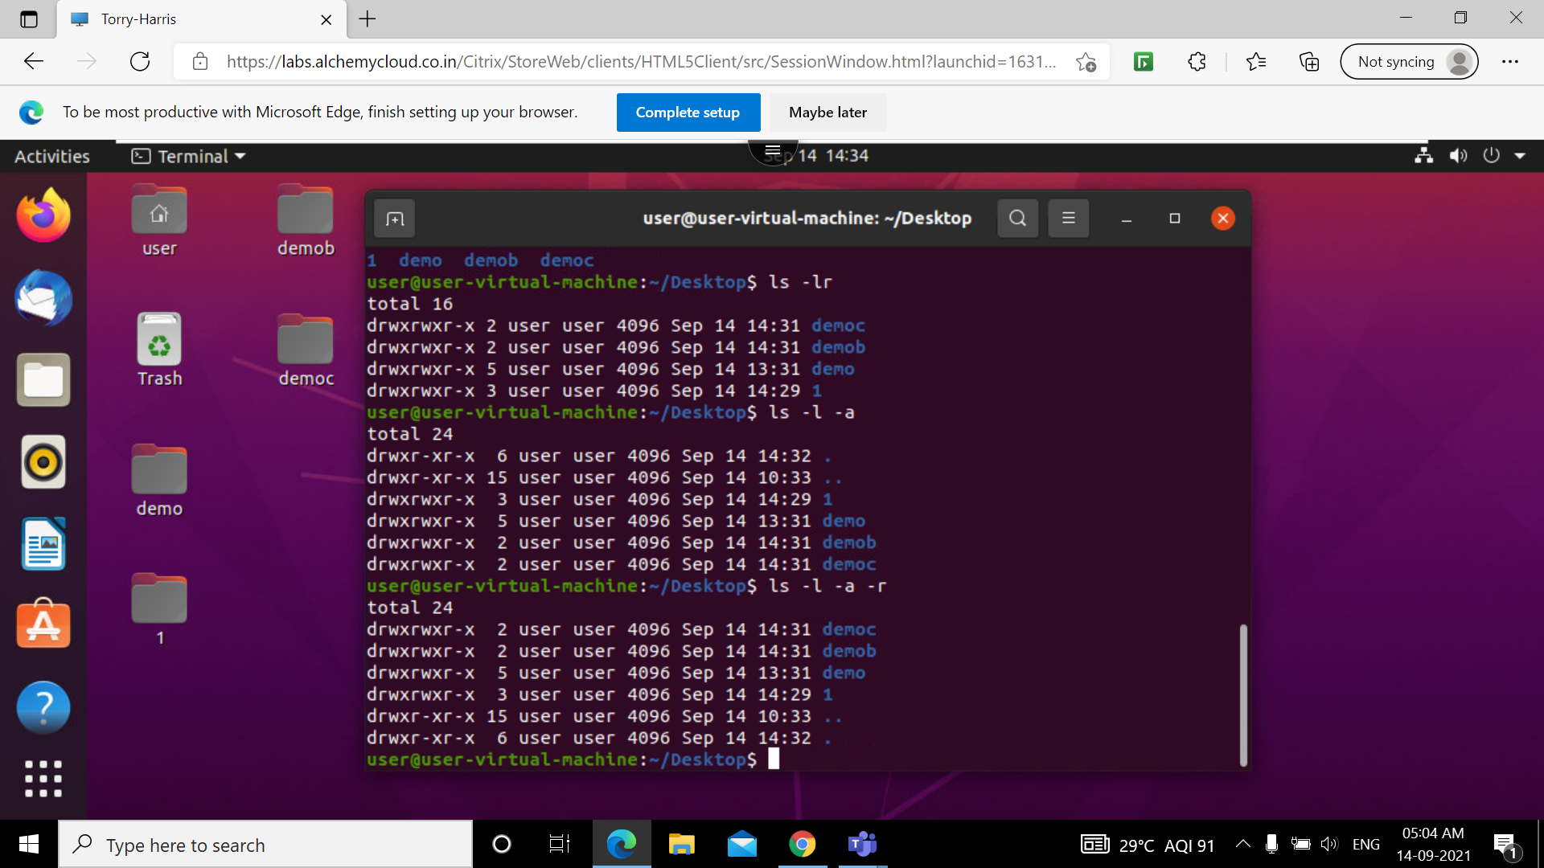
Ls -lr
Long lists the names of files in reverse order without displaying hidden files in a particular Unix directory

Slide 30
Ls –l -a
Long lists the names of files including hidden files in a particular Unix directory

Slide 31
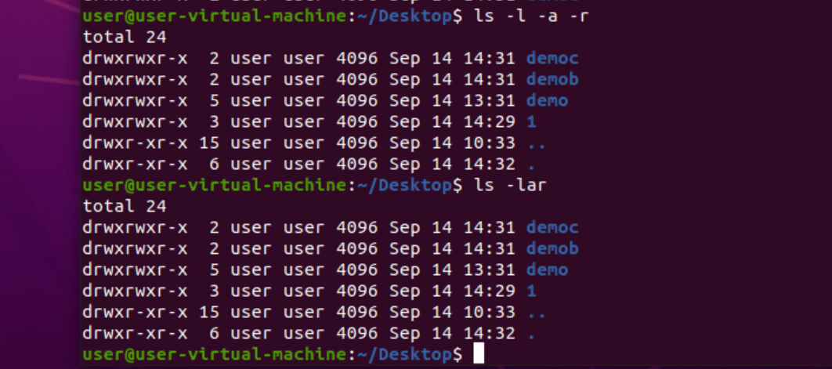
Ls –l –a -r
Long lists the names of files in reverse order including hidden files in a particular Unix directory

Slide 32
Ls -lar
-lar displays the same files, only now in reversed order of the last change, so that the file changed most recently occurs at the bottom of the list.

Slide 33
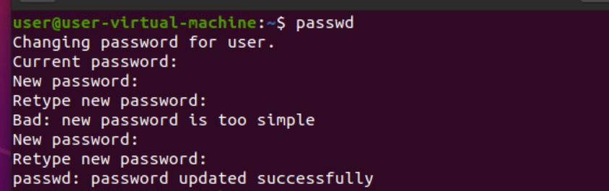
passwd
passwd is a command on Unix operating systems used to change a user's password.

Slide 34
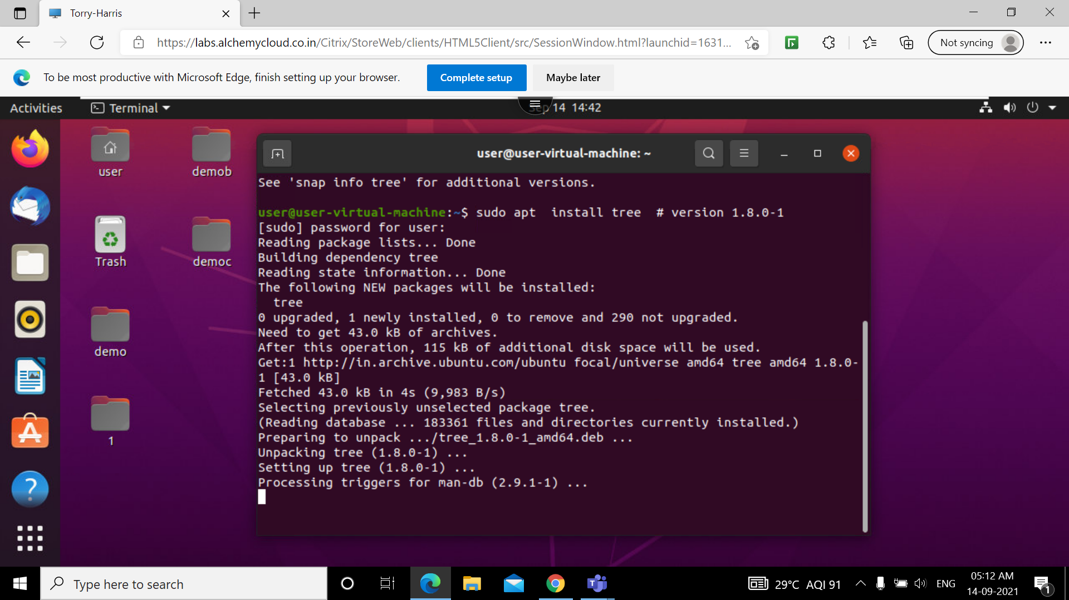
Sudo apt install
sudo apt-get install command is used to download the latest version of your desired application from an online software repository pointed to by your sources

Slide 35
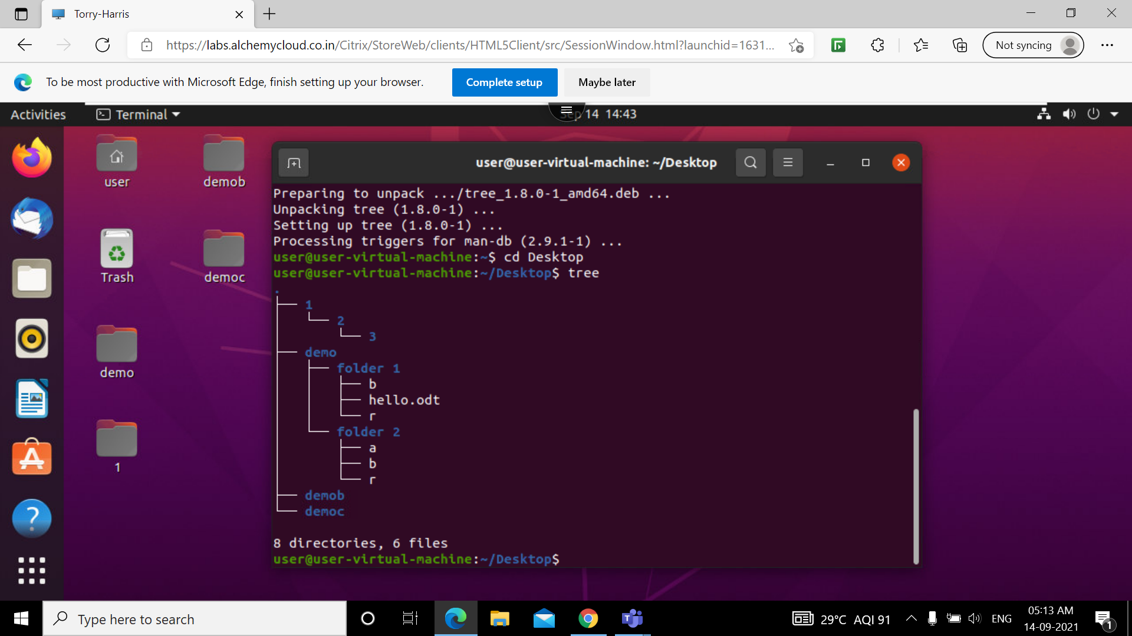
tree
tree is defined as a recursive directory listing program which generates a depth-indented file's list. Without any parameters, the tree lists the files in the present directory. At the time directory parameters are given, the tree alternately lists each file per directory found in the given directories.

Slide 36
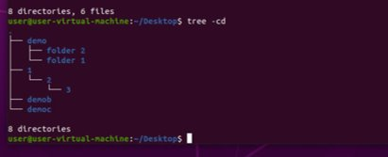
Tree -cd
This command is used to display all the directories hierarchically.

Slide 37
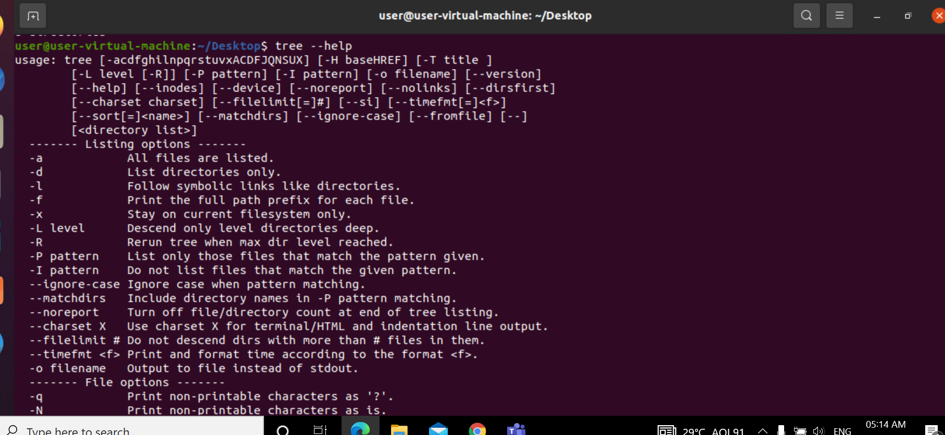
Tree --help
The help option provides a description of the major components of tree

Slide 38
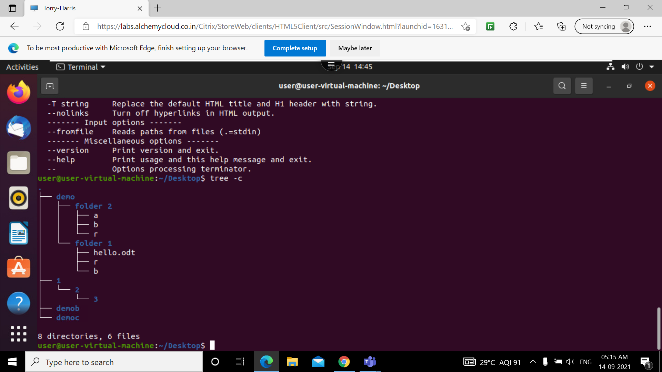
Tree -c
Sorts files by last status change time.

Slide 39
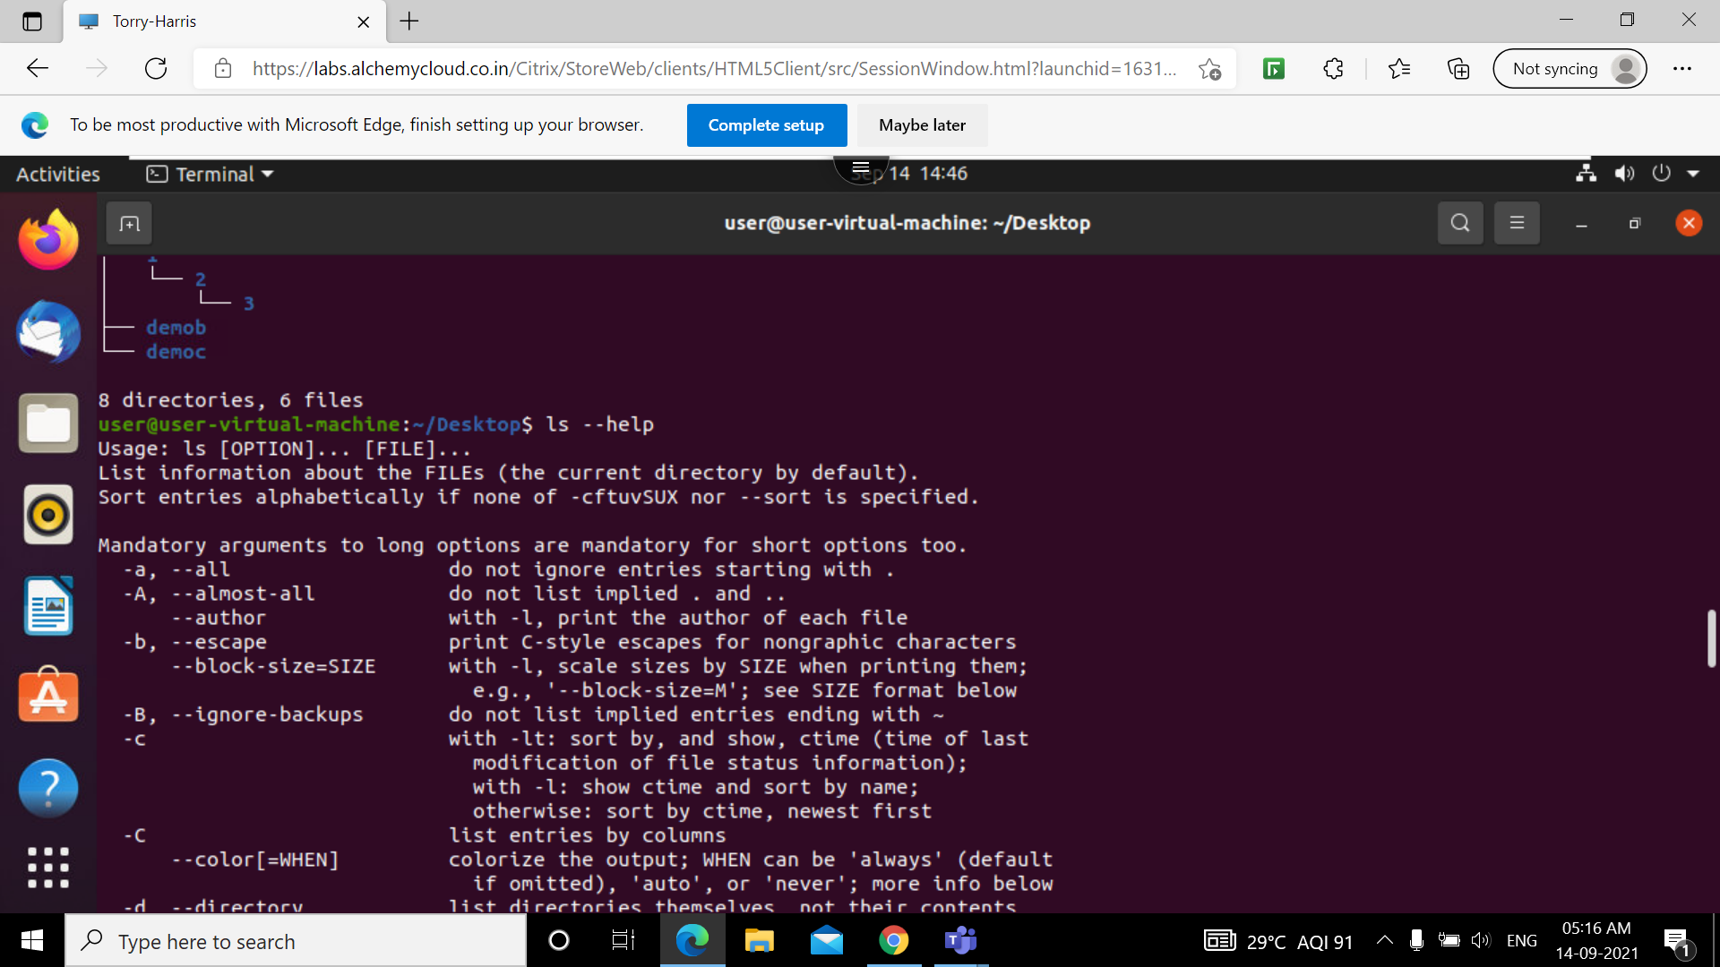
Ls --help
The help option provides a description of the major components of ls command

Slide 40
ECHO
Echo is a Unix/Linux command tool used for displaying lines of text or string which are passed as arguments on the command line. This is one of the basic command in linux and most commonly used in shell scripts.
CLEAR
Clear is a standard Unix computer operating system command that is used to clear the terminal screen. ... And this command will ignore any command-line parameters that may be present. Also, the clear command doesn't take any argument
EXIT
Exit command in linux is used to exit the shell where it is currently running

